Slide 1

Outpatient Demo
Q3 2023
Simon Jones

Slide 2
Agenda
Introduction Dashboard Overview Notes and steps in Readme

Slide 3
Questions
Outstanding Items:
What would I do if I had time
The beneficiary summary file has several chronic illness columns for each member. These are Boolean fields.
Convert these columns into a single categorical variable, concatenating multiple true diagnoses
If a member has 3 or more chronic conditions, categorise these as “Multiple” - Done
Join claims & benefit data Done – Inner Join
What is the distribution of races? Members Done Claim Count
What is the most common chronic illness combination (by countd members) Done
Which chronic illness combination has the total highest cost? done
Which chronic illness combination has the highest cost per member? done
For each provider & chronic illness, calculate the cost per member. (use AT_PHYSN_NPI) Done Tbl bottom left
For each chronic illness combination, represent the distribution of costs per provider. Done – Box plot
How does this change if we filter out cases where a given Chronic Illness (combination) & Provider NPI combination only has 1 member? Done
Which providers are consistently expensive across chronic illnesses they treat? Done box plot distribution
Any other significant metrics you think the business should be aware of?
During the interview, please be prepared to discuss coding techniques, libraries used etc. to answer the questions.

Slide 4
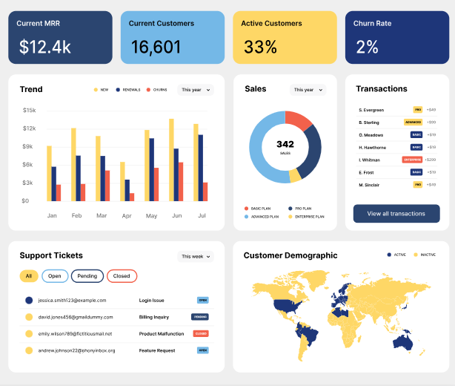


Slide 5
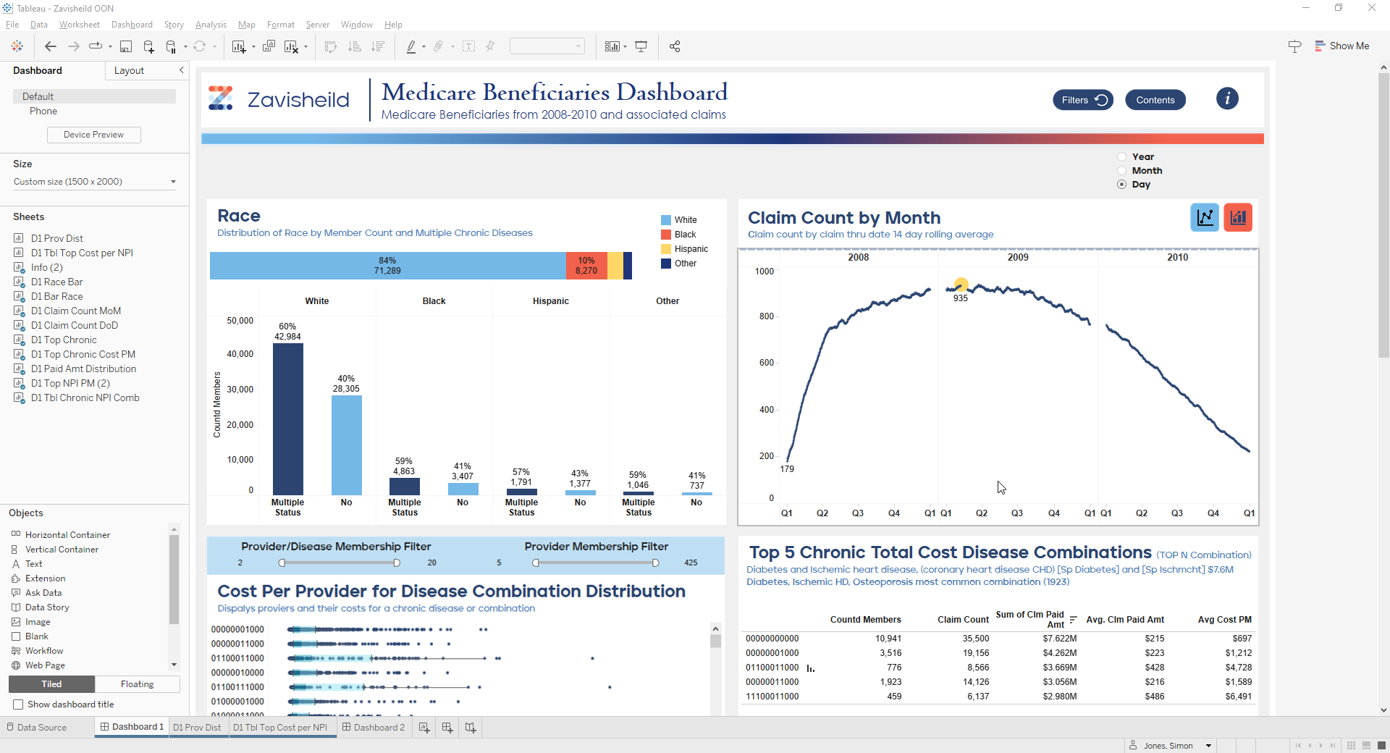
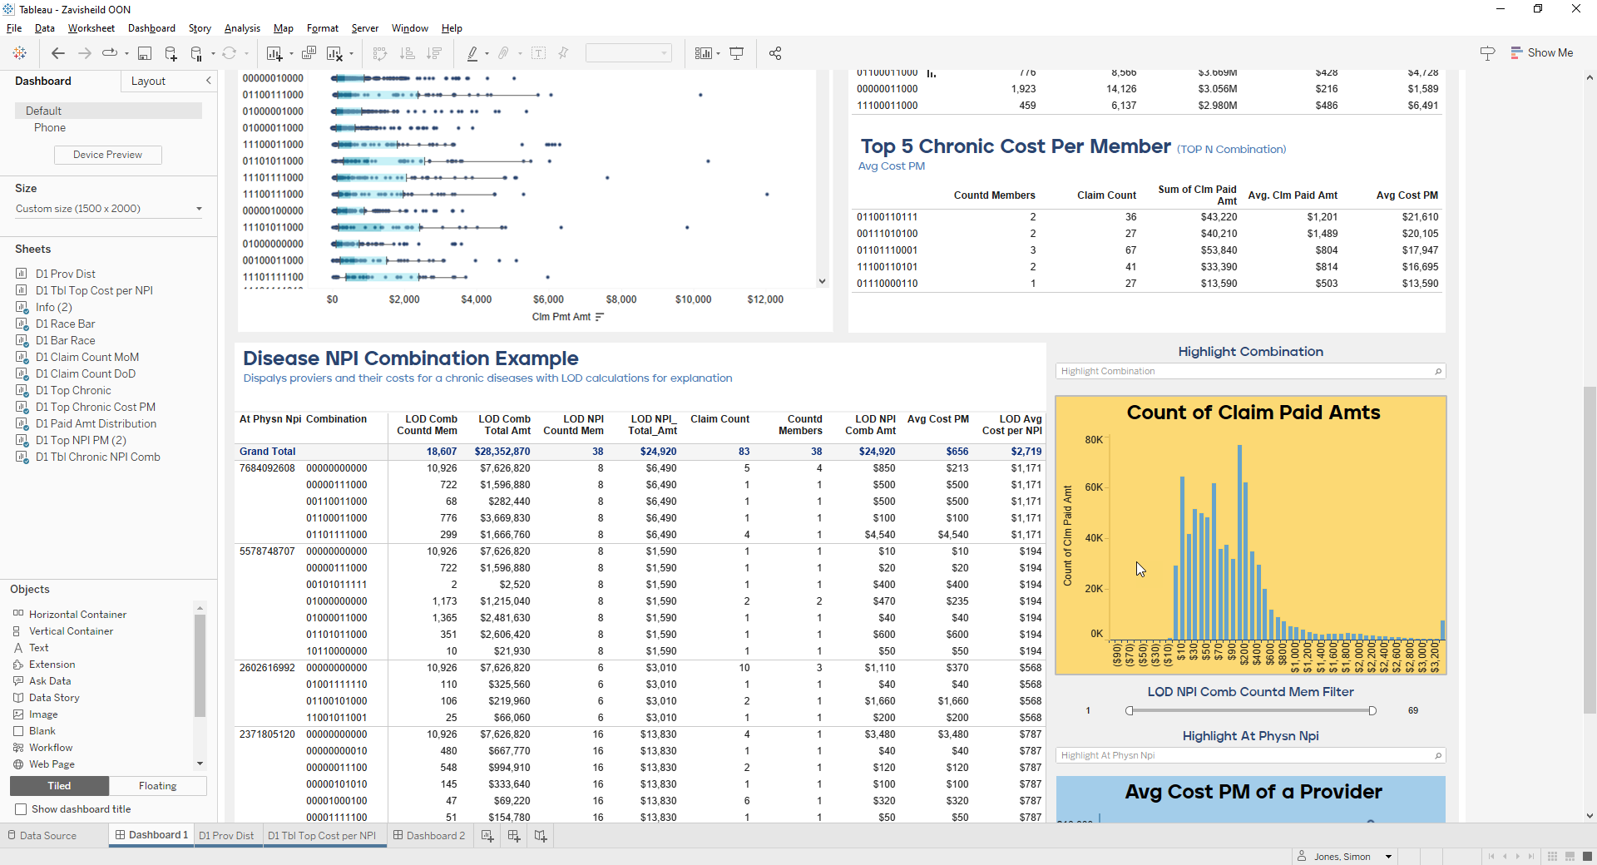
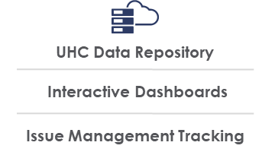









































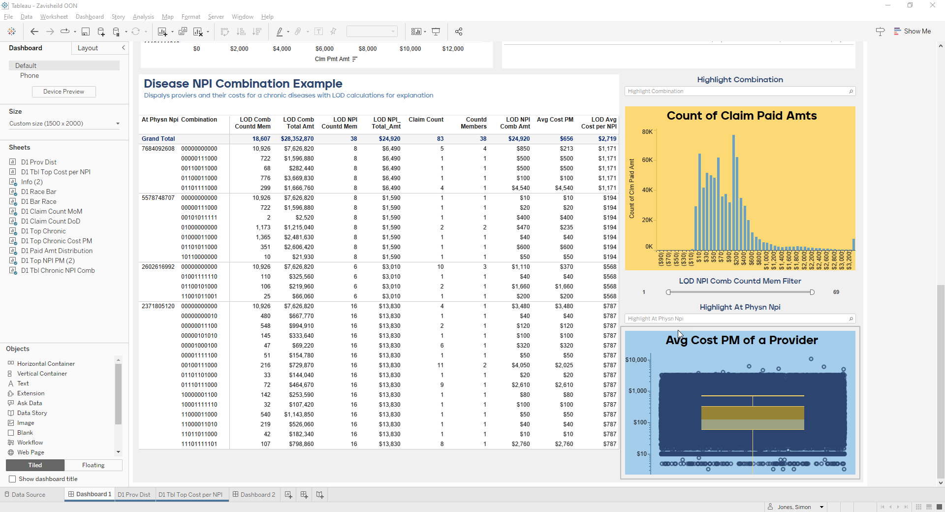






i
i
Filters
Filters
UHC Data Repository
Contents
Contents
Interactive Dashboards
Issue Management Tracking
Deep Dive
Deep Dive
Information
Information

Slide 6
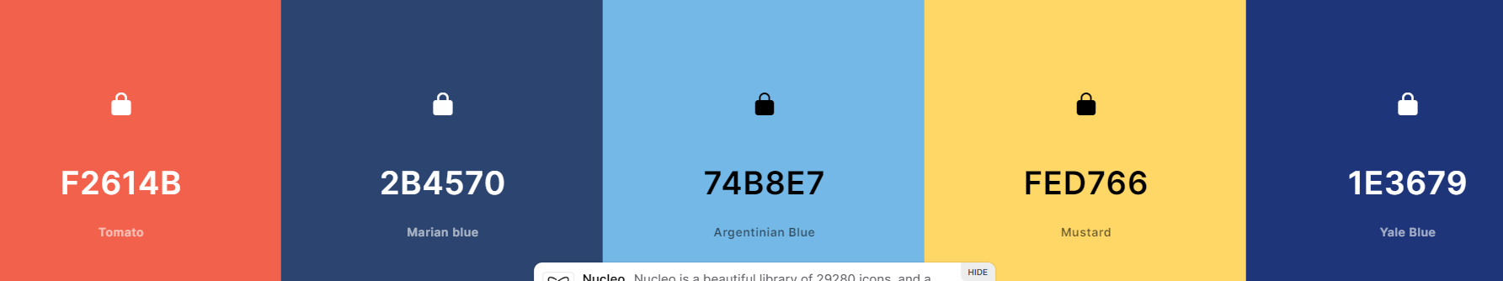

#E0E4ED

Slide 7
